Slide 1
２０１３年１月２８日PART II :Structural Singularities
Unfortunately, the two approaches proposed previously (Tarjan and tearing algorithms) still don’t always work:
i1 iC
1: u0 = f (t)
2: u1 = R1 · i1
3: u2 = R2 · i2
4: u_{L} = L · _{dt}
5: i_{C} =
i0
u1
u
di_{L}
R1
C
C
_{C ·} du_{C}
dt
+
R2
i
2
6:
7:
8:
u0 = u1 + u_{L}
u_{C} = u1 + u2
u_{L} = u2
U0
iL
-
R=20
u2
uL
9: i0
10: i1
= i1 + i_{C}
= i2 + i_{L}
L
Ground
⇒ We got again 10 implicitly formulated DAEs in 10 unknowns.

Slide 2
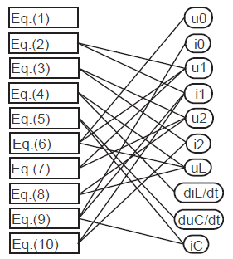
Structural Singularities II
Let us try the same approach. The structure digraph of the DAE system can be drawn as follows:

Slide 3
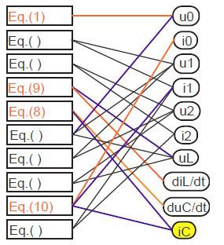
Structural Singularities III
◮ After four assignation steps, we got into troubles.
◮ The two connections attached to variable i_{C} have meanwhile both been colored in blue.
◮ Hence we are left without any equation to compute i_{C} .
◮ The DAE system contains a structural singularity.

Slide 4
Structural Singularities IV
Let us try another approach. We introduce the node potentials $\left(v_{0},v_{1},v_{2}\right)$ as additional variables:
v1
 |  | 1: | u0 | = | f (t)
i1 | iC | 2: | u0 | = | v1 − v0
 |  | 3: | u1 | = | R1 · i1
i1
iC
4: u1 = v1 − v2
5: u2 = R · i
6: u2 =
7: u_{L} =
8: u_{L} =
9: i_{C} = _{dt} 10: u = v1 − v0 11: v0 = 0
i0
u1
u
R1
C
C
2 2
v2 − v0
_{L ·} di_{L}
+
R2
dt
i
2
v2 − v0 _{C ·} du_{C}
U0 v
2
-
iL
R=20
C
u2
L
uL
12: i
13: i1
= i + i
= i2 + i_{L}
0
1 C
Ground
v0
⇒ We now got 13 implicitly formulated DAEs in 13 unknowns.

Slide 5
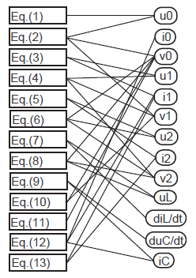
Structural Singularities V
The structure digraph of the DAE system can be drawn as follows:

Slide 6
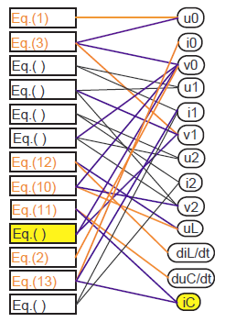
Structural Singularities VI
After a few steps of assignation:
◮ This time around, we were able to assign seven equations before getting into troubles.
◮ Once again, the two connections attached to variable i_{C} have meanwhile both been colored in blue.
◮ Hence we are left without any equation to compute i_{C} .
◮ However, we seem to have made the problem worse, in that we now also have an equation, the former Eq.(10), that has its two attached connections colored in blue.
◮ Hence Eq.(10) has now become redundant, and we won’t be able to use it at all.

Slide 7
Structural Singularity Elimination
Before we deal with the above circuit, let us choose a much simpler circuit that exhibits the same problems.
R
1: u0 = f (t)
2: u_{R} = R · i0
3: i1 =
4: i2 =
i₁
i₂
_{C1 ·} du₁
i₀
dt
u
_{C2 ·} du₂
R
dt
+
5: u0 = u_{R} + u1
6: u2 = u1
U₀
C1
C2
-
u
u₂
7: i = i + i
1
0 1 2
⇒ We now got 7 implicitly formulated DAEs in 7 unknowns.

Slide 8
Structural Singularity Elimination II
◮ If we apply Tarjan algorithm then u1 and u2 should be state variables, and thus both u1 and u2 are considered known variables. Then, Eq.(6) has no unknown left. It must be considered as constraint equation. (non-zero index DAE).
The equations can now easily be brought into an assignment form:
◮ We can change the assigned variable in one the capacitive equations, solving
for the variable i2, instead of ^{du2} . Consequently, the solver has to solve for
du₂
dt
_{dt} instead of u2 (thus the integrator has been turned into a differentiator).
◮ In the model equations, u2 must now be considered an unknown, whereas ^{du2} is
considered a known variable.
dt

Slide 9
Structural Singularities
Structural Singularity Elimination III
How to compute $\frac{du_{2}}{dt} ?$
◮ Numerical differentiation is a bad idea if explicit formulae are being used. These algorithms are highly unstable.
◮ Using implicit formulae, numerical integration and differentiation are essentially the same, but implicit formulae call for an iteration at every step.
◮ Pantelides proposed a different approach, described as follows:
Note that
u2 (t) = u1 (t), $∀ t$
$$\frac{du_{2}(t)}{dt}= \frac{du_{1}\left(t\right)}{dt} , ∀ t$$
Implies that

Slide 10
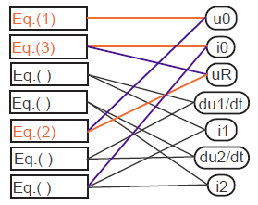
Structural Singularity Elimination IV
Thus, we can symbolically differentiate the constraint equation, and replace the constraint equation by its derivative:
u0 = f (t)
u_{R} = R · i0
du1
with the partially assigned structure digraph:
i1 = C1 ·
dt du2
dt
i2 = C2 ·
u0 = u_{R} + u1
du2 ₌du1 dt dt
i0 = i1 + i2
◮ The constraint equation has indeed disappeared. After partial causalization of the equations, we are now faced with an algebraic loop in four equations and four unknowns, a situation that we already know how to deal with.

Slide 11
Structural Singularity Elimination V
This approach works, but has a disadvantage.
◮ We again have two integrators in the model that we can seemingly integrate separately and independently of each other.
◮ Yet, this is an illusion. The constraint on the capacitive voltages has not disappeared. It has only been hidden (=“hidden constraint equations”)
◮ It is true that we can now numerically integrate ^{du1} into u1 , and ^{du2} into u2 .
dt dt
However, they both must fulfill the initial conditions.
◮ The second integrator does not represent a true state variable. In fact, it is wasteful. We don’t need two integrators, since the system has only one degree of freedom, i.e., one energy storage.

Slide 12
Structural Singularity Elimination VI
Let us modify the approach. We shall augment the set of equations by the differentiated constraint equation in order to keep track of the initial conditions:
u0 = f (t)
u_{R} = R · i0
du1
◮ We now have one equation too many. We need to throw another equation away.
◮ We throw one of the integrators away, e.g. the one that computes u2 out of _{dt} .
i1 = C1 ·
du₂
dt du2
dt
i2 = C2 ·
◮ Now, both u2 and ^{du2} are considered
dt
unknowns, and we have eight model
u0 = u_{R} + u1
equations in eight unknowns.
u2 = u1
du2 ₌du1 dt dt
i0 = i1 + i2

Slide 13
Structural Singularity Elimination VII
We shall replace ^{du2} by du2 to symbolize that this is now an algebraic variable:
dt
u0 = f (t)
u_{R} = R · i0
du1
with the partially assigned structure digraph:
Eq.(1)
u0 i0 uR
i1 = C1 ·
dt
Eq.(4)
i2 = C2 · du2 u0 = u_{R} + u1 u2 = u1
du1
Eq.( )
Eq.( )
du1/dt
Eq.(3)
i1 u2 du2 i2
du2 = _{dt}
Eq.(2)
i0 = i1 + i2
Eq.( )
Eq.( )
◮ We are again faced with an algebraic loop in four equations and four unknowns.

Slide 14
Structural Singularity Elimination VIII
◮ The differentiation index is a measure of the constraints among equations.
◮ An index-0 DAE contains neither algebraic loops nor structural singularities.
◮ An index-1 DAE contains algebraic loops, but no structural singularities.
◮ A DAE with a different index > 1, a so-called higher-index DAE, contains structural singularities.
◮
The algorithm by Pantelides is a symbolic index reduction algorithm.
Each application of the algorithm reduces the perturbation index by one. Hence it may be necessary to apply the Pantelides algorithm more than once.
◮
◮
It is not surprising that, after applying the Pantelides algorithm, we ended up with an algebraic loop. This is usually the case.

Slide 15
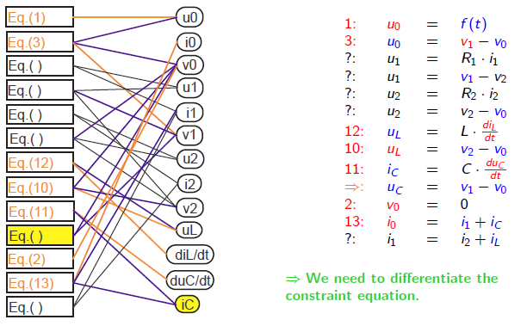
Structural Singularity Elimination IX
Let us now return to our original circuit:

Slide 16
Structural Singularity Elimination X
1: u0 = f (t)
3: u0 = v1 − v0
?: u1 = R1 · i1
?: u1 = v1 − v2
?: u2 = R2 · i2
?: u2 = v2 − v0
12: u_{L} =
10: u_{L} =
11: i_{C} =
⇒: u_{C} =
2: v0 = 0
13: i0 = i1 + i_{C}
?: i1 = i2 + i_{L}
1: u0
3: u0
?: u1
?: u1
?: u2
?: u2
13: u_{L}
11: u_{L}
= f (t)
= v1 − v0
= R1 · i1
= v1 − v2
= R2 · i2
= v2 − v0
=
=
_{L ·} di_{L}
⇒
_{L ·} di_{L}
dt
dt
v2 − v0
v2 − v0 C · du_{C} v1 − v0
_{C ·} du_{C}
12: | i_{C} | =
4: | u_{C} | =
10: | du_{C} | =
2: | v0 | =
14: | i0 | =
?: | i1 | =
dt
v1 − v0
dv1 − dv0
0
i1 + i_{C}
i2 + i_{L}
◮ In the process of differentiation, we introduced two new variables, dv0 and dv1 , for which we don’t have equations yet. We need to differentiate the equations defining v0 and v1 and add them to the set of equations.

Slide 17
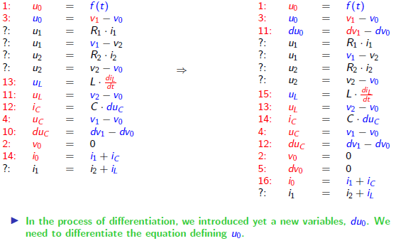
Structural Singularity Elimination XI

Slide 18
Structural Singularity Elimination XII
1: u0 = f (t)
3: u0 = v1 − v0
11: du0 = dv1 − dv0
?: u1 = R1 · i1
?: u1 = v1 − v2
?: u2 = R2 · i2
?: u2 = v2 − v0
15: u_{L}
1: u0 = f (t)
_{6: du0 =} df (t)
dt
3: u = v
12: du0 = dv1 − dv0
?: u1 = R1 · i1
?: u1 = v1 − v2
?: u2 = R2 · i2
?: u2 = v2 − v0
16: u_{L} =
14: u_{L} =
15: i_{C} =
4: u_{C} =
13: du_{C} =
2: v0 = 0
5: dv0 = 0
17: i0 = i1 + i_{C}
?: i1 = i2 + i_{L}
v
0
1 − 0
⇒
=
_{L ·} di_{L}
dt
_{L ·} di_{L}
13: 14: | u_{L} i_{C} | = = | v2 − v0 C · du_{C}
4: | u_{C} | = | v1 − v0
12: 2: | du_{C} v0 | = = | dv1 − dv0 0
5: 16: ?: | dv0 i0 i1 | = = = | 0 i1 + i_{C} i2 + i_{L}
dt
v2 − v0 C · du_{C} v1 − v0
dv1 − dv0
◮ We are done. We now have an algebraic loop in five equations and five unknowns.

Slide 19
Structural Singularity Elimination XIII
Let us now return to the original description of the model without the 3 node potentials ($v_{0},v_{1},v_{2})$
Eq.(1)
Eq.( )
Eq.( )
Eq.(9)
Eq.(8)
Eq.( )
Eq.( )
Eq.( )
Eq.(10)
Eq.( )
u0 i0 u1 i1 u2 i2
uL
◮ We got stuck without finding a constraint equation.
◮ We ended up with an algebraic loop in six equations, but only five unknowns, as the sixth unknown, ic , doesn’t appear in the algebraic loop.
◮ The constraint equation is hidden inside the algebraic loop.
⇒ In this situation, we need to differentiate the entire algebraic loop and add the differentiated equations to the set.
diL/dt duC/dt iC

Slide 20
Structural Singularity Elimination XIV
1: ?: ?: | u0 u1 u2 | = = = | f (t) R1 ·i1 R2 ·i2
9: | u_{L} | = | _{L} $∙\frac{di_{L}}{dt}$
8: | $$i_{C}$$ | $$=$$ | _{C}$∙$
?: ?: ?: 10: ?: | u0 u_{C} u_{L} i0 i1 | = = = = = | u1 + u_{L} u1 + u2 u2 i1 + i_{C} i2 + i_{L}
Eq.(1)
Eq.( )
Eq.( )
Eq.(9)
Eq.(8)
Eq.( )
Eq.( )
Eq.( )
Eq.(10)
Eq.( )
u0 i0 u1 i1 u2 i2
uL
$$\frac{du_{C}}{dt}$$
diL/dt
duC/dt
⇒ We need to differentiate the entire algebraic loop and remove one of the integrators that appears inside the loop equations.
iC

Slide 21
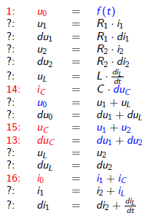
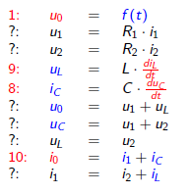
Singularities
Structural Singularity Elimination XV
$$⟹$$
◮ In the process of differentiation, we introduced yet a new variables, du0 . We need to differentiate the equation defining u0 .

Slide 22
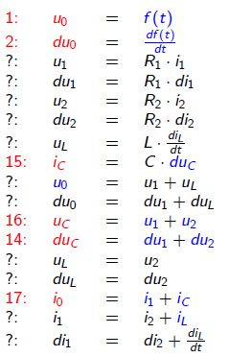
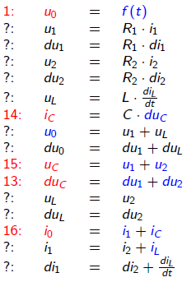
Structural Singularity Elimination XVI
⇒
◮ We ended up with 17 equations in 17 unknowns, containing an algebraic loop of 11 equations and 11 unknowns.

Slide 23
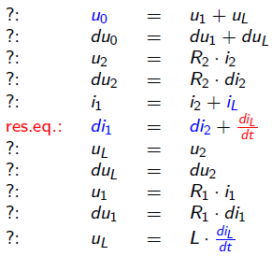
Tearing Algebraic Loops
Let us look at the algebraic loop equations after selection of a tearing variable and a residual equation:
Eq.( )
u1 du1 i1 di1 u2 du2 i2 di2
uL
duL diL/dt
Eq.( )
Eq.( )
Eq.( )
Eq.( )
Res.Eq.
Eq.( )
Eq.( )
Eq.( )
Eq.( )
Eq.( )

Slide 24
Numerical Simulation of Dynamic Systems XVI Differential Algebraic Equations III
Tearing Algebraic Loops
Tearing Algebraic Loops II
A few assignation steps later:
◮ We seem to have gotten stuck with another constraint equation.
Eq.(2)
u1 du1 i1 di1 u2 du2 i2 di2
uL
duL diL/dt
Eq.( )
◮ Yet, this is a very different problem from the one discussed before. This constraint was caused by a poor selection of a tearing variable and a residual equation.
Eq.(5)
Eq.( )
Eq.( )
Res.Eq.
◮ Had we chosen a different tearing variable or a different residual equation, this problem would not have occurred.
Eq.(3)
Eq.( )
Eq.(4)
Eq.( )
◮ Sometimes, our simple heuristics for the selection of tearing variables and residual equations maneuver themselves into a corner, and in those situations, we must be prepared to backtrack.
Eq.(1)

Slide 25
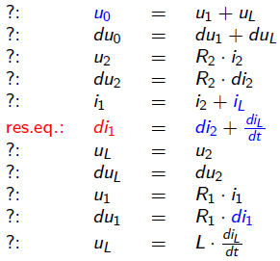
Tearing Algebraic Loops III
Let us select a different tearing variable from the same residual equation:
Eq.( )
u1 du1 i1 di1 u2 du2 i2 di2
uL
duL diL/dt
Eq.( )
Eq.( )
Eq.( )
Eq.( )
Res.Eq.
Eq.( )
Eq.( )
Eq.( )
Eq.( )
Eq.( )

Slide 26
Tearing Algebraic Loops IV
A few assignation steps later:
◮ We were able to assignation six of the eleven equations.
Eq.( )
u1 du1 i1 di1 u2 du2 i2 di2
Eq.(2)
◮ We thus need to select a second residual equation and a second tearing variable, in order to complete the assignation of the algebraic equation system.
Eq.( )
Eq.(10)
Eq.( )
Res.Eq.
Eq.( )
Eq.(8)
uL duL diL/dt
Eq.( )
Eq.(1)
Eq.(9)

Slide 27
Conclusions (of Part II: Structural Singularities)
◮ In this presentation, we looked at the problem of structural singularities contained in the set of DAEs extracted from an object-oriented description of the system to be simulated.
◮ We discussed a variant of the Pantelides algorithm for the systematic index reduction in structurally singular (higher-index) models.
◮ The algorithm is very efficient and has been successfully implemented in Dymola and also in a number of other object-oriented modeling and simulation environments.
◮ Yet, Dymola uses a more complex set of heuristics for selecting the tearing variables, one that has furthermore not been published and is therefore not available for discussion.

